Slide 1

Memcomb
Noah Bradley, Bryce Waters, Isaac Watson, Jizhou Zhang, Andrew Dever, Kyle King

Slide 2
Memcomb
For those who want to share and connect through similar memories in their lives. The Memcomb application is a social media platform that allows users to upload photos, videos, and audio, with an attached caption, that displays an important event in their lives. Unlike similar applications, Memcomb will connect users who share events of a similar time and place, allowing those users to discover each other. Our product provides a new way for users to interact with one another.
Noah

Slide 3
This Sprint
Establish important key terminology
Re-designed database schema
Implemented database schema
Researched timeline / feed, discussed algorithm
(Almost) Creating our first memory
Creating FTP server for file/memory upload
Implemented functions for uploading background image
Designed Template for a Settings page and Timeline page
Research ImageMagick and Ffmpeg
Image editors
Noah

Slide 4
Challenges and Risks
Designing Database Schema
File server
Tracing path to upload images
Discussing our terminology and what a user should see when creating a memory
Changing database schema required C# controller and html updates
Which caused some ugliness thanks to bootstrap
Isaac

Slide 5
Mitigation Plan
Spent time as a group discussing terminology and what we all agreed as the best path, with respect to creating memories
Developed alternate methods of storing images within the database in case our desired method was deemed infeasible.
Researching ways to find the correct code that traces a path to image uploading
Bootstrap can be tedious to work around, but as time goes on our understanding improves
Isaac

Slide 6
What is a ‘Memory’
Memories are events in our head, and all have a time and place
A memory fragment is any single post a user creates. This could be an image, a video, an audio clip, or a text story. These fragments have a specific location and date, and can be sorted by specific keywords
A memory is a collection of fragments, where users can group posts under one event. Each post has its own location, date, and keywords, however they are all grouped as a singular event
Example: Your trip to Florida when your family visited 4 different amusement parks
Kyle

Slide 7
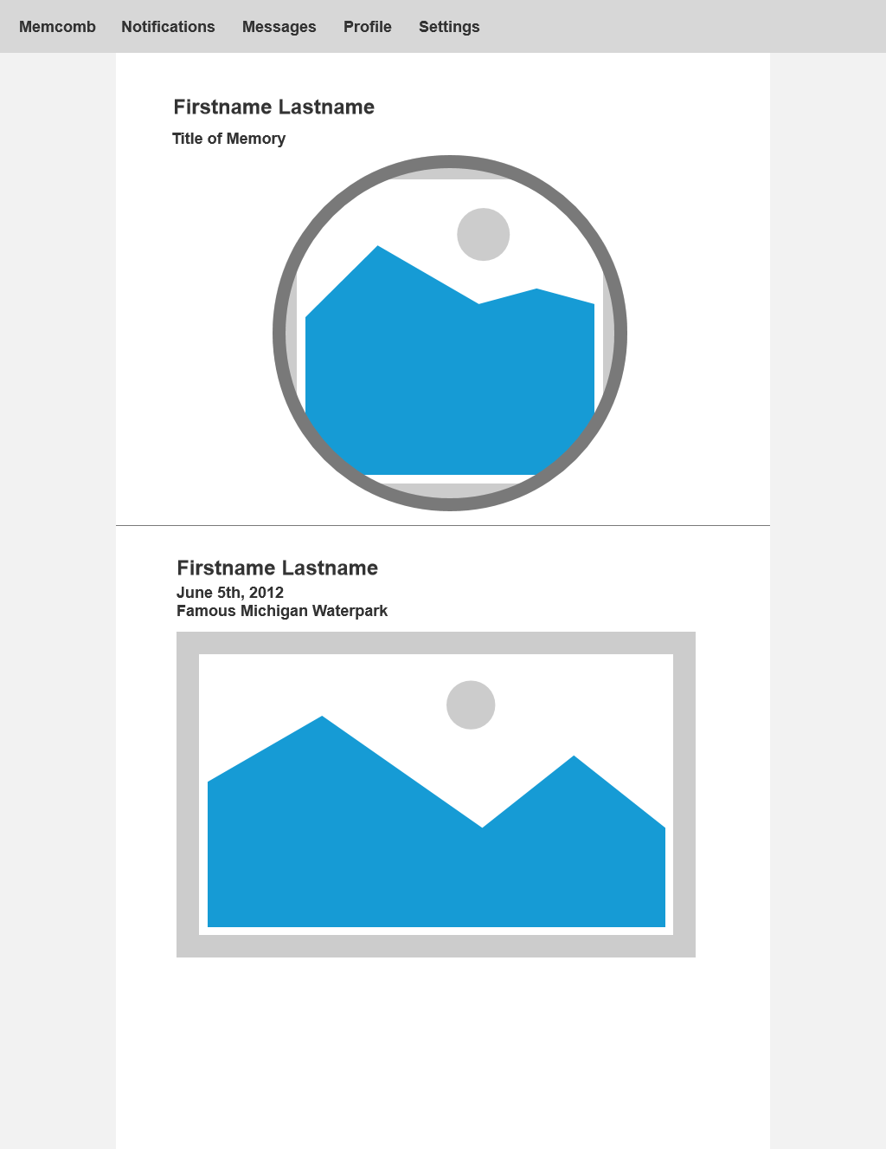
Wireframes
Kyle

Slide 8
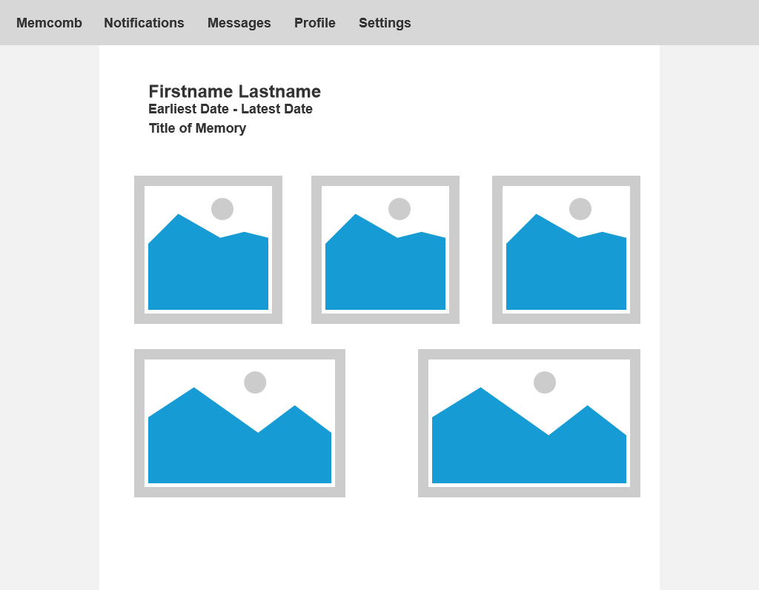

Slide 9
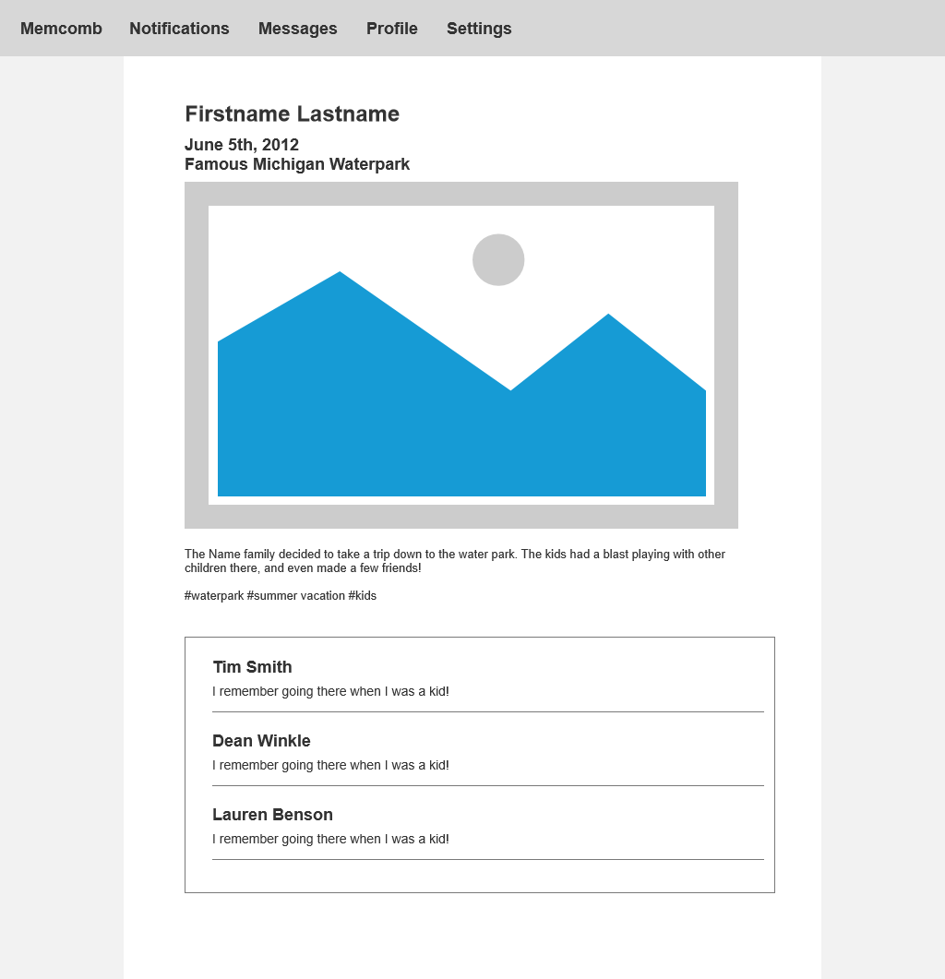

Slide 10
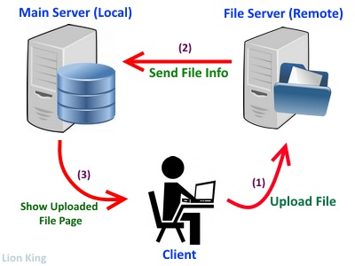
Memory Creation
Upload will go to the File server
Database will receive the image from the file server
File will then be stored in the database
Bryce

Slide 11
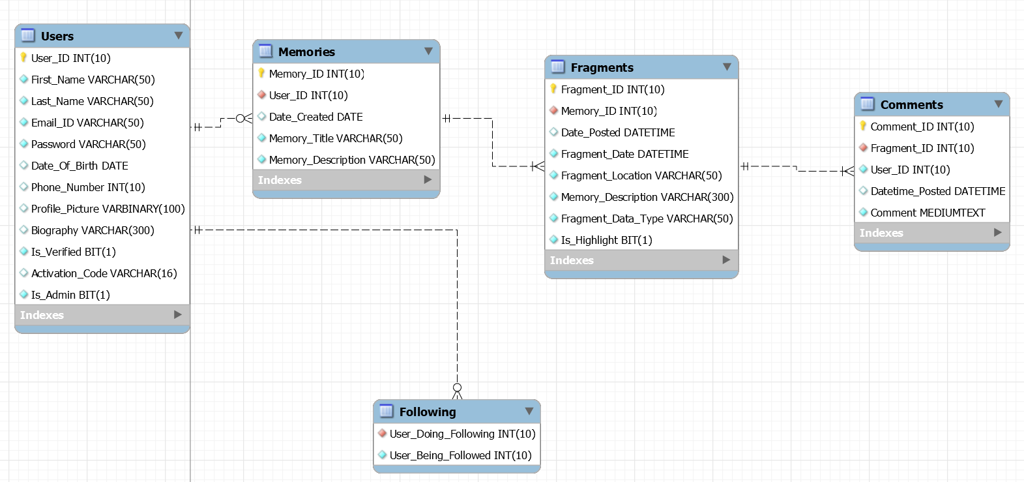
Current EERD

Slide 12
User Stories
This Sprint
As a user I want to be able to upload a memory
As a user I want to be able to view my profile
As a user I want to able to upload a background image
As a user I want to be able to view a settings page
Next Sprint
As a user I need to be able to view memories uploaded by my friends
Possibly create connections between those who are not yet friends
Jizhou

Slide 13
Next Sprint Objectives
Allow users to see memories made by their friends
Add to account management and allow more customization
Fix the HTML / CSS for all pages so they match nicely together
Continue adding to the schema as ideas or processes change
Automated Testing
Jizhou

Slide 14
Demo

